Slide 1

HYBRID BERT-BASED FAKE NEWS DETECTION USING LINGUISTIC FEATURES AND EXPLAINABLE AI
Department of Artificial Intelligence and Machine Learning
Vels Institute of Science, Technology & Advanced Studies (VISTAS)
Presented by
Mohamed Irfaan M (24619122)
Bhuvanesh M (24619104)
Harish Hariharan MU (24619114)
Guided by
Dr.Anandan.R

Slide 2
Abstract
The rapid spread of misinformation through digital news platforms has created a need for reliable and interpretable fake news detection systems. This project, Hybrid BERT-Based Fake News Detection Using Linguistic Features and Explainable AI, proposes a text-based classification system that combines contextual language representations with handcrafted linguistic features to classify news articles as real or fake.
The proposed system uses a pretrained, frozen BERT model (`bert-base-uncased`) to extract a 768-dimensional contextual representation from the input text. This representation is combined with 19 handcrafted linguistic features to form a 787-dimensional feature vector. A Logistic Regression classifier processes this combined representation to predict whether the submitted news article is real or fake. To improve interpretability, SHapley Additive exPlanations (SHAP) are used to identify features that contribute to the model's predictions. The system is deployed through a Streamlit web application that accepts a news title and article and displays the predicted classification with supporting explanations.
Keywords: Fake News Detection, BERT, Linguistic Features, Logistic Regression, SHAP, Explainable Artificial Intelligence, Streamlit.

Slide 3
Problem Statement
The rapid circulation of online news makes it difficult for readers to distinguish genuine information from misinformation. Traditional text classification methods may fail to capture contextual meaning, while complex machine learning models can be difficult to interpret.
Therefore, this project aims to develop a text-based fake news detection system that combines contextual representations from BERT with handcrafted linguistic features. It also incorporates explainability through SHAP to help users understand the factors influencing predictions.
The system must be evaluated on both internal test data and an external dataset to examine its performance beyond the original evaluation setting.

Slide 4
Objectives
1. To develop a text-based fake news detection system using a pretrained BERT model.
2. To extract contextual text representations using `bert-base-uncased`.
3. To combine BERT embeddings with 19 handcrafted linguistic features.
4. To classify news articles using Logistic Regression.
5. To use SHAP to explain model predictions.
6. To develop an interactive Streamlit application for entering news text and viewing predictions.
7. To evaluate the system using internal test data and an external IFND dataset.

Slide 5
Literature Survey
Paper | Year | Main Approach | Key Finding / Limitation
Park & Chai – User-Centered Fake News Detection | 2023 | XGBoost + LR, RF, SVM, CART, NNET | Uses content, user and network characteristics; identifies need for explainable and more general systems.
Kang et al. – User Engagements in Korean Fake News Detection | 2022 | K-FANG, GraphSAGE + Bi-LSTM | Uses user-news interactions and social context; K-FANG outperformed the KoBERT baseline.
Almarashy et al. – Fused Multi-Modal Features | 2024 | BERT + CNN + GRU + ResNet-CBAM + Autoencoder + FLN | Combines text and image features; achieved 88% on Weibo and 98% on Fakeddit.
Gedara et al. – Explainable Multimodal Fake News Detection | 2025 | Prompt Learning + AutoML + Functional Network | Combines text/image modalities and explicitly addresses explainability.

Slide 6
Research Gap
Existing Systems Lack
Limited multi-source feature integration
Limited contextual understanding of news content
Lack of explainable predictions
High computational cost in complex deep-learning models
Our Approach
BERT for contextual text representation
19 linguistic features for text analysisUser & network features for additional information
Logistic Regression* for classification.
SHAP for explainable predictions.
Streamlit for interactive detection

Slide 7
Existing System
The original Park & Chai system considers three major categories of information:
1. Content Features
Sentiment
Text similarity
Readability / linguistic characteristics
2. User Features
Number of tweets
Likes
Retweets
User activity
3. Network Features
Followers/following
Network centrality
User relationships
XGBoost is used for feature selection, followed by:
LR | Random Forest | SVM | CART | Neural Network
The models are compared to identify the best-performing classifier.
Limitations
Primarily focused on Twitter.
English-only data.
Classical ML-based classification.
Ensemble predictions can be difficult to interpret.
The paper itself identifies the need for higher accuracy and explainable AI.

Slide 8
Proposed System
Step 1 — Data Input
Enter news title and article in Streamlit
Step 4 — Feature Fusion
Combine both feature sets into a 787-dimensional vector.
Step 7 — Evaluation
Internal test accuracy: 99.2%.
External IFND evaluation accuracy: 70.10%.
Evaluate generalization across datasets.
Step 2 — Text Preprocessing
Combine title and article.
Tokenize text for BERT input.
Step 5 — Classification
. Logistic Regression predicts Real or Fake.
Step 3 — Feature Extraction
BERT → 768-dimensional contextual embeddings.
Linguistic analysis → 19 handcrafted features.
Step 6 — Explainability
SHAP identifies influential features in the prediction.

Slide 9
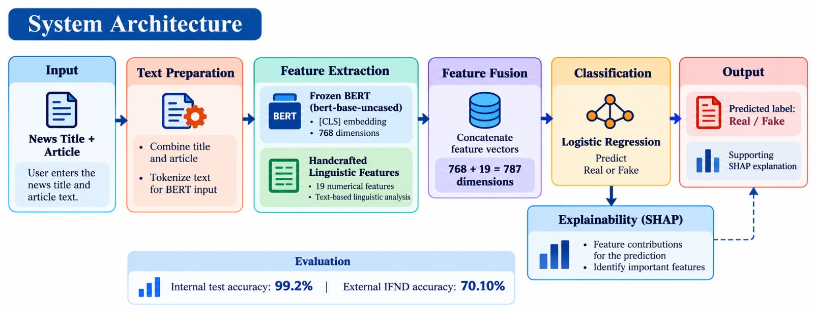
System Architecture

Slide 10
Technology Used
Development
Python – Core programming language.
Streamlit – Interactive web application..
Machine Learning & NLP
BERT – Contextual text feature extraction.
Handcrafted Linguistic Features* – 19 numerical text features.
Scikit-learn – Logistic Regression classification
Explainable AI
SHAP – Feature contribution and prediction explanation.
Data Processing
Pandas – Dataset processing.
NumPy – Numerical operations.
Model & Storage
Pickle – Saved classifier model serialization.
Hugging Face Transformers – BERT model and tokenizer..
Tools
Git & GitHub – Version control and project management.

Slide 11
Data Set
Dataset Sources
Internal test set: 1,500 samples.External evaluation using the Indian Fake News Dataset (IFND).External dataset size: 56,714 samples.Input consists of news titles and article text.Labels: Real (0) and Fake (1).
Evaluation Results
Internal test accuracy: 99.2%External accuracy: 70.10%Fake-news precision: 53.22%Fake-news recall: 85.43%Fake-news F1-score: 65.58%ROC-AUC: 83.16%
Key Finding: The 29.10 percentage-point accuracy gap highlights the challenge of generalizing to an external dataset.

Slide 12
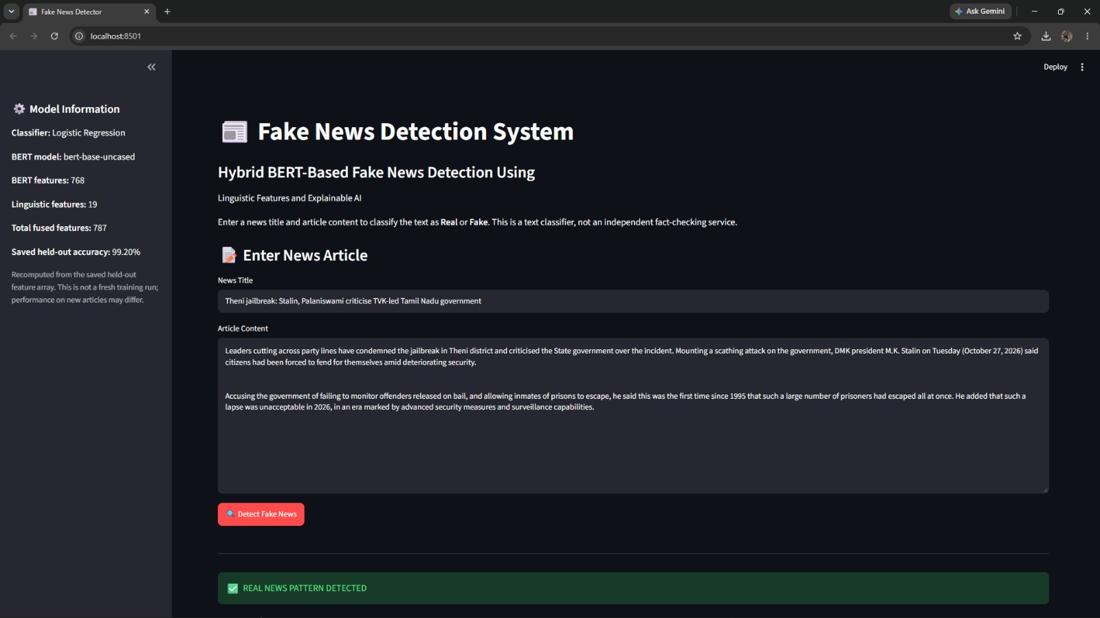
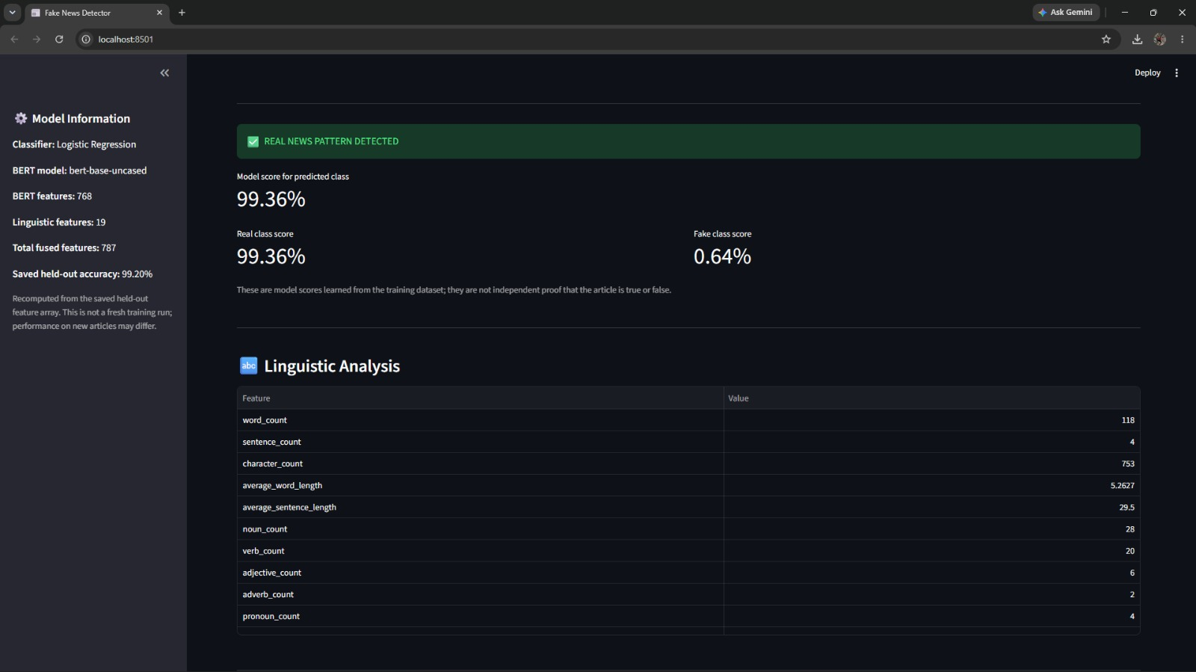
Result

Slide 13
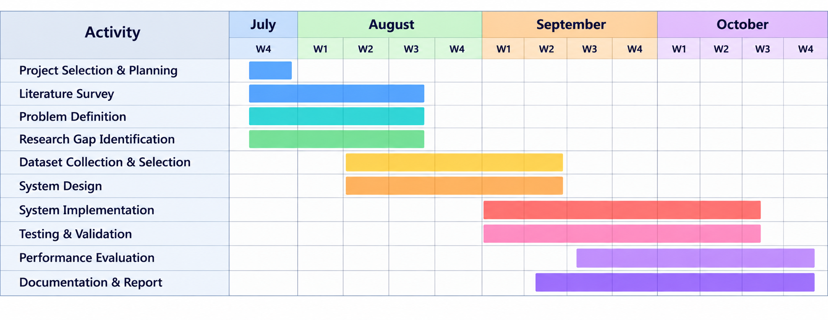
Gantt Chart

Slide 14
Conclusion
Combines 768-dimensional frozen BERT embeddings with 19 handcrafted linguistic features..
Uses a 787-dimensional feature vector with Logistic Regression for classification.Applies SHAP to explain feature contributions to predictions..
Achieves 99.2% internal test accuracy on 1,500 samples..
Achieves 70.10% external accuracy on the IFND dataset, indicating a generalization challenge..
Future Scope
Evaluate on more diverse, independently sourced datasets..
Investigate publisher, topic, and dataset bias..
Document and validate all 19 linguistic features.
Improve model robustness and explanation reliability.
Note: SHAP explains model predictions; it does not independently verify whether a news claim is true.

Slide 15
References
[1] J. Devlin, M.-W. Chang, K. Lee, and K. Toutanova, “BERT: Pre-training of Deep Bidirectional Transformers for Language Understanding,” in Proceedings of NAACL-HLT, 2019, pp. 4171–4186.
[2] S. M. Lundberg and S.-I. Lee, “A Unified Approach to Interpreting Model Predictions,” in Advances in Neural Information Processing Systems (NeurIPS), vol. 30, 2017.
[3] D. K. Sharma and S. Garg, “IFND: A Benchmark Dataset for Fake News Detection,” Complex & Intelligent Systems, vol. 9, pp. 2843–2863, 2023.
[4] A. K. Shu, A. Sliva, S. Wang, J. Tang, and H. Liu, “Fake News Detection on Social Media: A Data Mining Perspective,” ACM SIGKDD Explorations Newsletter, vol. 19, no. 1, pp. 22–36, 2017.
[5] K. Shu, A. Sliva, S. Wang, J. Tang, and H. Liu, “Beyond News Contents: The Role of Social Context for Fake News Detection,” in Proceedings of the 12th ACM International Conference on Web Search and Data Mining (WSDM), 2019.“Fake News Detection System Using Featured-Based Optimized MSVM Classification,” IEEE Access, vol. 10, 2022.

Slide 16
THANK YOU

